Slide 1
Lecture 3: Getting Started with Python
CoTaPP: Computational Thinking and Programming with Python

Slide 2

Announcements
Project 1 assignment, rubric, groups → Blackboard

Slide 3


Slide 4

StudyLens
CoTaPP: Computational Thinking and
Programming with Python

Slide 5
StudyLens
Python practice tool
  Developed at Utrecht University
  Content comes from:
    University of Pittsburgh
    Book: Python for Everybody → https://www.py4e.com/book.php
System:
  Blackboard → “Course Information”→ “StudyLens”
  https://studylens.science.uu.nl/
Credentials:
  Blackboard → “My Grades”→ “StudyLens”
Goal: use a educational tool to improve your knowledge of Python

Slide 6
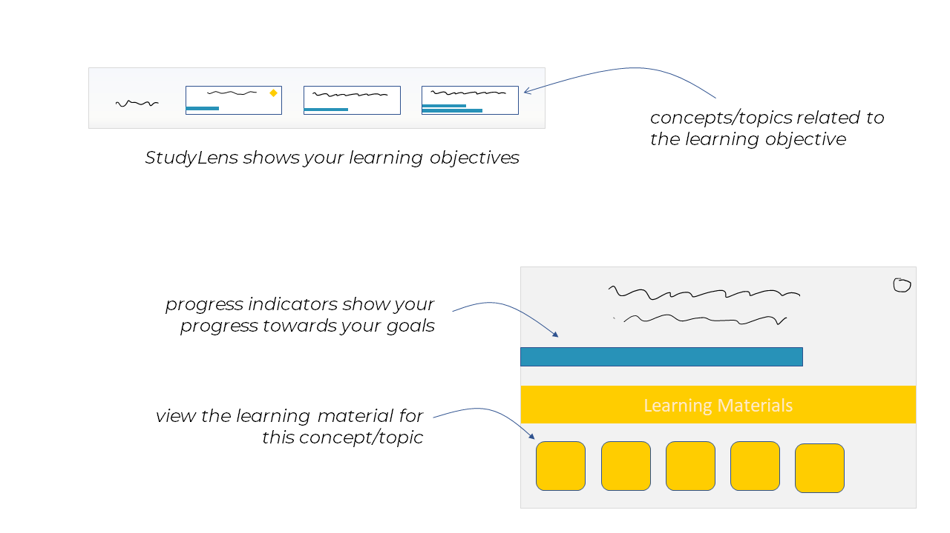

Slide 7
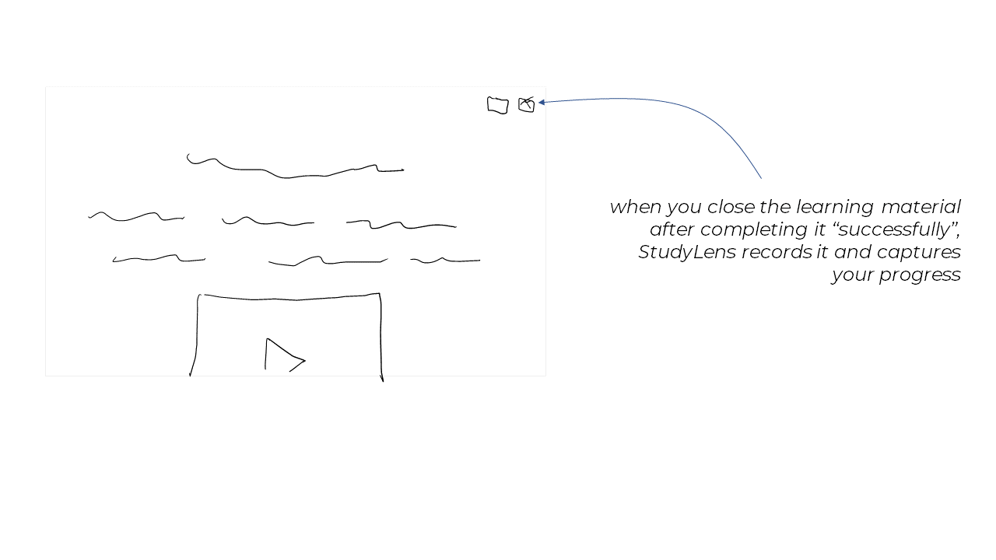

Slide 8
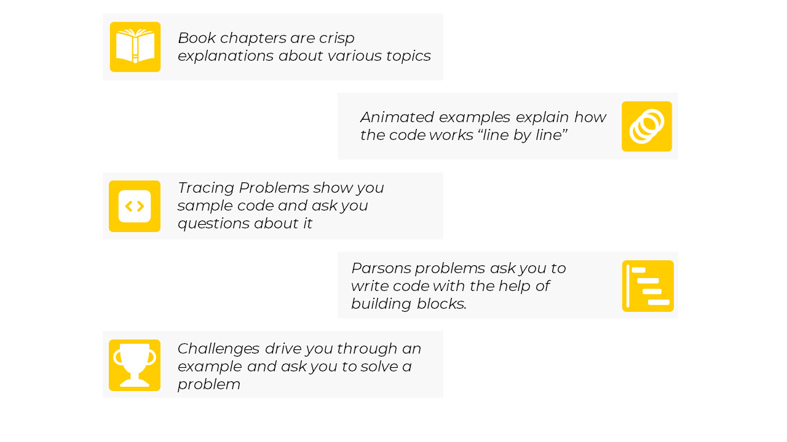

Slide 9
StudyLens
Data:
  all user/usage data is completely anonymous
  researchers only will see, user: cotapp23sXX
  consent to use the data for research purposes
3% bonus on the final grade:
  sign consent (later, at the end of the course)
  Fill in a survey (later, at the end of the course)
  at least 75% of all the activities

